Slide 1
Science 8
Problem-Solving Chapter
Review for Test

Slide 2
Science 8—Problem Solving
Lesson 1-Vocabulary

Slide 3
science

Slide 4
science
the investigation and exploration of natural events and of the new information that results from those investigations

Slide 5
observation

Slide 6
observation
using one or more of your senses to gather information and taking note of what occurs

Slide 7
inference

Slide 8
inference
logical explanation of an observation that is drawn from prior knowledge or experience

Slide 9
hypothesis

Slide 10
hypothesis
possible explanation for an observation that can be tested by scientific investigations

Slide 11
prediction

Slide 12
prediction
statement of what will happen next in a sequence of events

Slide 13
scientific theory

Slide 14
scientific theory
explanation of observations or events that is based on knowledge gained from many observations and investigations

Slide 15
scientific law

Slide 16
scientific law
rule that describes a repeatable pattern in nature

Slide 17
technology

Slide 18
technology
practical use of scientific knowledge, especially for industrial or commercial use

Slide 19
critical thinking

Slide 20
critical thinking
comparing what you already know with the information you are given in order to decide whether you agree with it

Slide 21
Marie Curie

Slide 22
Marie Curie
a scientist who won two Nobel prizes in the early 1900s for her work with radioactivity

Slide 23
physical science
the study of matter and energy

Slide 24
physical science
the study of matter and energy

Slide 25
life science

Slide 26
life science
the study of life and the processes that occur in living organisms, such as plants and animals

Slide 27
Earth science

Slide 28
Earth science
the study of processes that occur on Earth. Astronomy is often included in the earth sciences.

Slide 29
Science 8—Problem Solving
Lesson 2-Vocabulary

Slide 30
description

Slide 31
description
spoken or written summary of observations

Slide 32
explanation

Slide 33
explanation
interpretation of observations

Slide 34
International System of Units (SI)

Slide 35
scientific notation

Slide 36
scientific notation
method of writing or displaying very small or very large numbers

Slide 37
percent error

Slide 38
percent error
expression of error as a percentage of the accepted value

Slide 39
precision

Slide 40
precision
a description of how similar or close repeated measurements are to each other

Slide 41
accuracy

Slide 42
accuracy
a description of how close a measurement is to an accepted value

Slide 43
balance

Slide 44
balance
scientific tool used to measure the mass of an object

Slide 45
thermometer

Slide 46
thermometer
scientific tool used to measure the temperature of substances.

Slide 47
spring scale

Slide 48
spring scale
scientific tool used to measure the weight or the amount of force of an object

Slide 49
Science 8—Problem Solving
Lesson 3-Vocabulary

Slide 50
variable

Slide 51
variable
any factor that can have more than one value

Slide 52
constant

Slide 53
constant
factor in an experiment that stays the same

Slide 54
independent variable

Slide 55
independent variable
factor that you want to test; is changed by the investigator to observe how it affects a dependent variable

Slide 56
dependent variable

Slide 57
dependent variable
factor you observe or measure during an experiment

Slide 58
experimental group

Slide 59
experimental group
used to study how a change in the independent variable changes the dependent variable

Slide 60
control group

Slide 61
control group
contains the same factors as the experimental group, but the independent variable is not changed

Slide 62
qualitative data

Slide 63
qualitative data
words used to describe what is observed

Slide 64
quantitative data

Slide 65
quantitative data
numbers used to describe what is observed

Slide 66
scientific method

Slide 67
scientific method
a process of critical thinking that uses observations and experiments to investigate testable predictions about the physical universe system of measurement

Slide 68
control

Slide 69
control
the part of the experiment that is used for comparison

Slide 70
controlled experiment

Slide 71
controlled experiment
a scientific investigation that tests how one factor affects another

Slide 72
hypothesis

Slide 73
hypothesis
a possible explanation for an observation that can be tested by scientific investigations

Slide 74
Review

Slide 75
metric system
Convert!
Kilometers to meters
Meters to kilometers

Slide 76
graduate cylinder

Slide 77
graduate cylinder
scientific tool to measure volume of a liquid

Slide 78
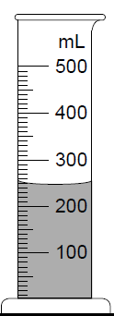
graduate cylinder
What is the volume of the liquid?

Slide 79
graduate cylinder
What is the volume of the liquid?
250 mL

Slide 80
triple beam balance

Slide 81
triple beam balance
scientific tool used to measure the mass of an object

Slide 82
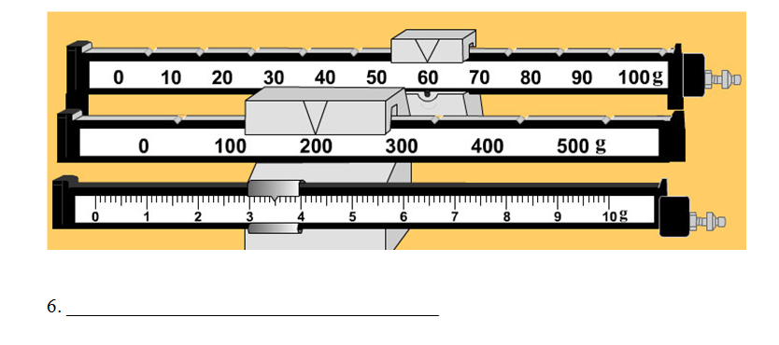
triple beam balance
What is the mass?

Slide 83
200 + 60 + 3 + 0.5= x
What is the mass?

Slide 84
200 + 60 + 3 + 0.5= x x = 263.5 g
What is the mass?

Slide 85
spring scale

Slide 86
spring scale
scientific tool used to measure the weight or the amount of force of an object

Slide 87
hypothesis

Slide 88
hypothesis
scientific tool used to measure the weight or the amount of force of an object

Slide 89
technology

Slide 90
technology
practical use of scientific knowledge, especially for industrial or commercial use

Slide 91
controlled group
contains the same factors as the experimental group, but the independent variable is not changed

Slide 92
controlled group
contains the same factors as the experimental group, but the independent variable is not changed

Slide 93
experimental group

Slide 94
experimental group
used to study how a change in the independent variable changes the dependent variable

Slide 95
variable

Slide 96
variable
any factor that can have more than one value

Slide 97
constant

Slide 98
constant
factor in an experiment that stays the same factor in an experiment that stays the same

Slide 99
independent variable

Slide 100
independent variable
factor that you want to test; is changed by the investigator to observe how it affects a dependent variable

Slide 101
dependent variable

Slide 102
dependent variable
factor you observe or measure during an experiment

Slide 103
qualitative data

Slide 104
qualitative data
words used to describe what is observed

Slide 105
quantitative data

Slide 106
quantitative data
numbers used to describe what is observed

Slide 107
physical science

Slide 108
physical science
the study of matter and energy

Slide 109
life science

Slide 110
life science
the study of life and the processes that occur in living organisms, such as plants and animals

Slide 111
Earth science

Slide 112
Earth science
the study of processes that occur on Earth. Astronomy is often included in the Earth sciences.

Slide 113
scientific law

Slide 114
scientific law
rule that describes a repeatable pattern in nature

Slide 115
scientific theory

Slide 116
scientific theory
explanation of observations or events that is based on knowledge gained from many observations and investigations

Slide 117
observation

Slide 118
observation
using one or more of your senses to gather information and taking note of what occurs

Slide 119
description

Slide 120
description
spoken or written summary of observations

Slide 121
explanation

Slide 122
explanation
interpretation of observations

Slide 123
inference

Slide 124
inference
logical explanation of an observation that is drawn from prior knowledge or experience

Slide 125
critical thinking

Slide 126
critical thinking
comparing what you already know with the information you are given in order to decide whether you agree with it

Slide 127
science

Slide 128
science
the investigation and exploration of natural events and of the new information that results
from those investigations

Slide 129
Earth science
the study of processes that occur on Earth. Astronomy is often included in the Earth sciences.

